Slide 1

AuE-8230 Autonomy: Science and Systems
Capstone Project
Group 1: Chinmay Samak, Tanmay Samak
Codebase

Slide 2
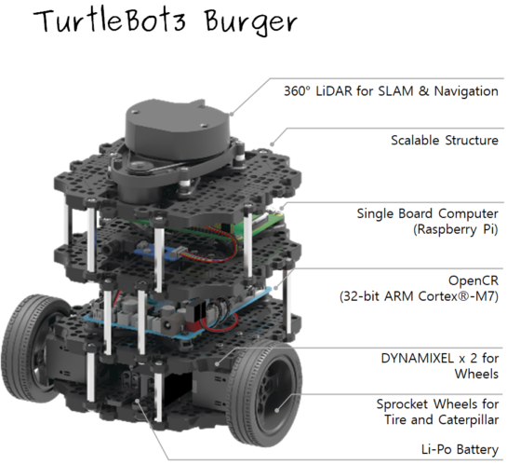
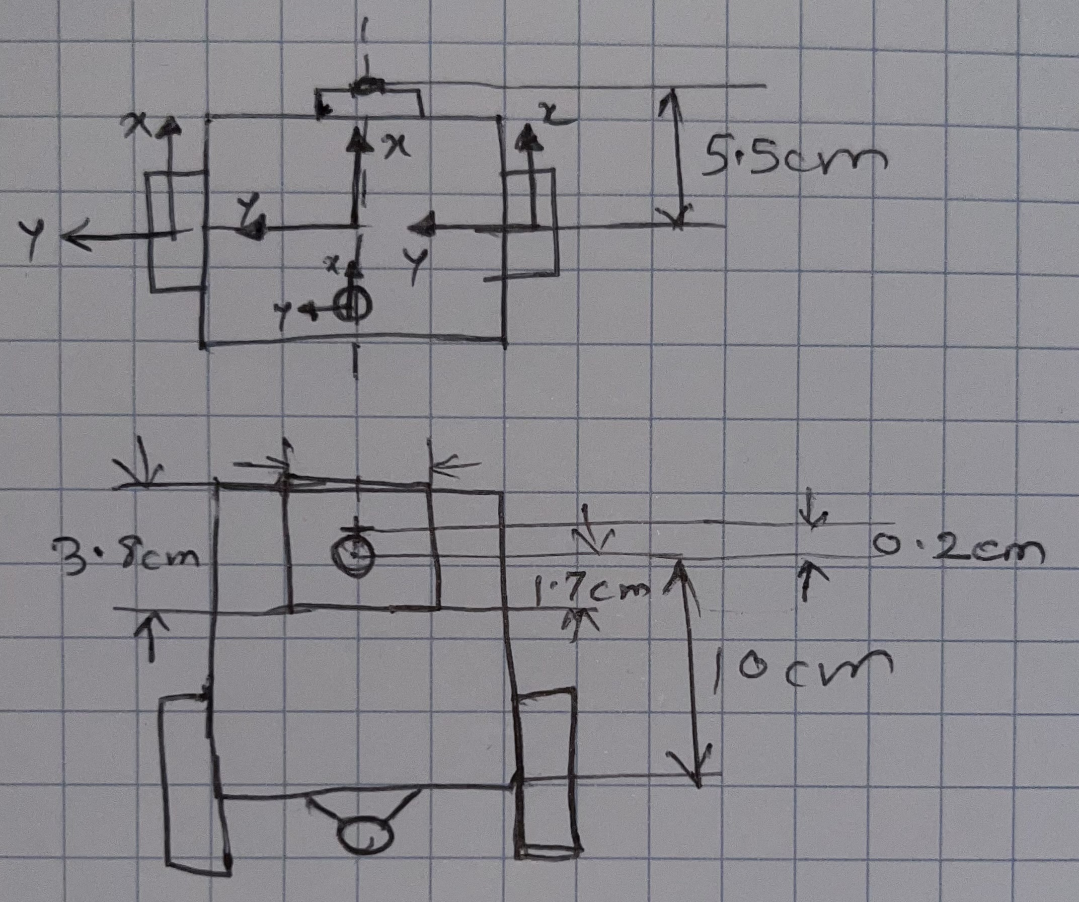
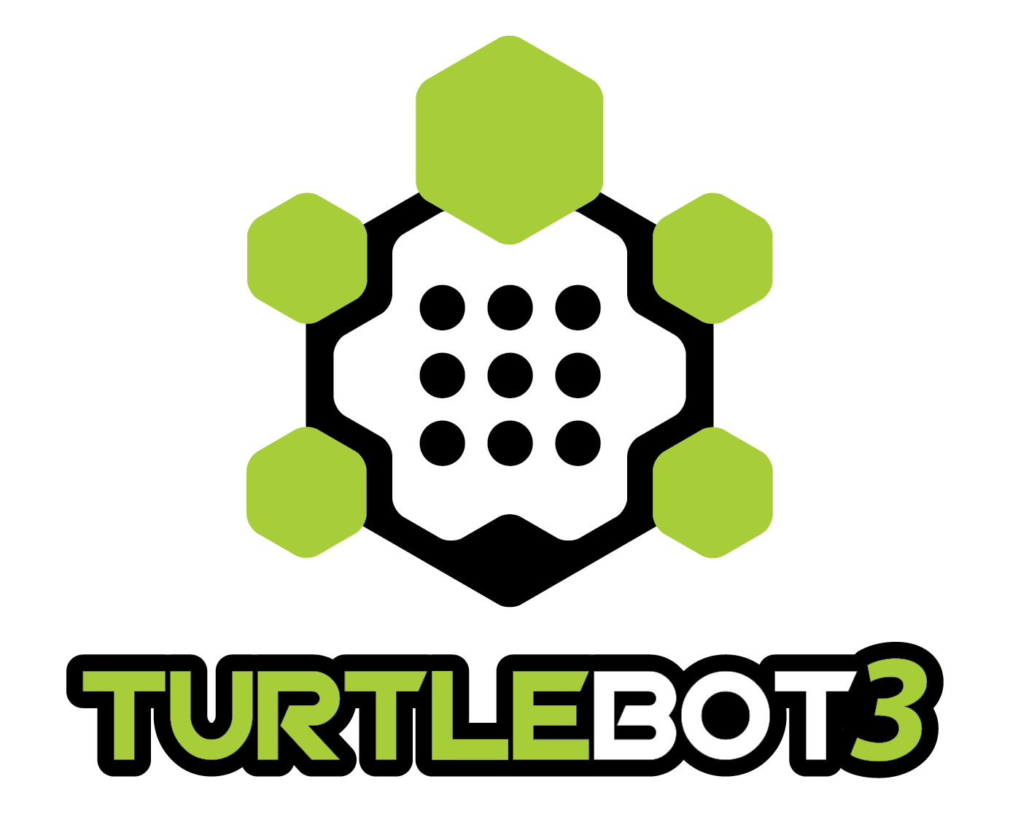

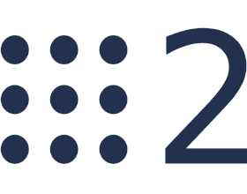

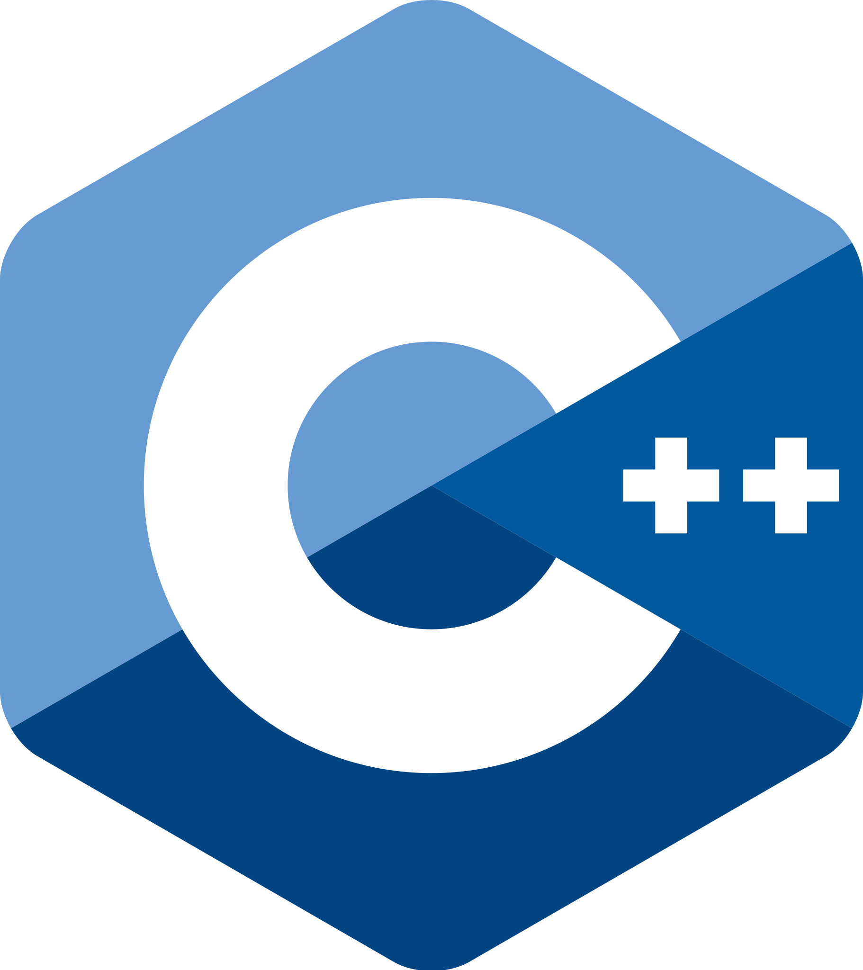
Project Tools
Robot: TurtleBot3 Burger (with camera)
Simulation: Gazebo
Framework: ROS 2 Foxy
Programming: Python, C++
Source: Robotis Inc.

Slide 3
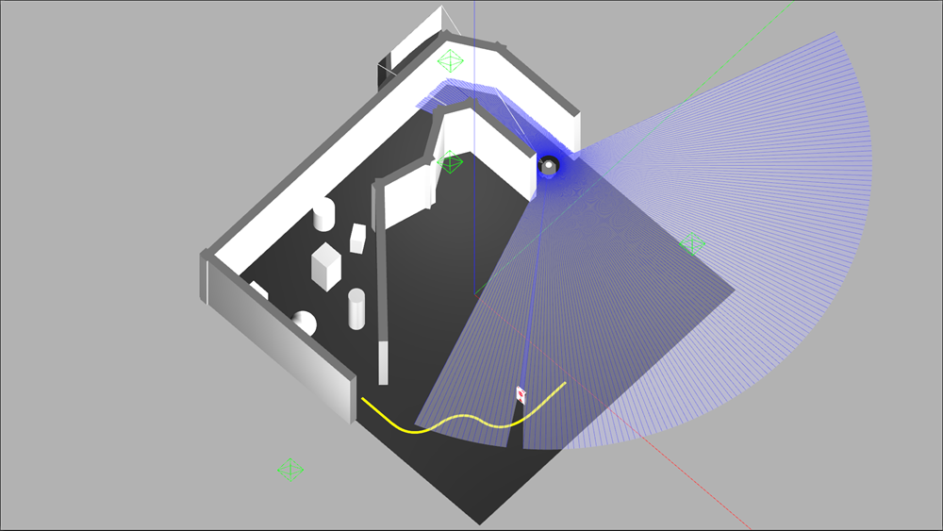
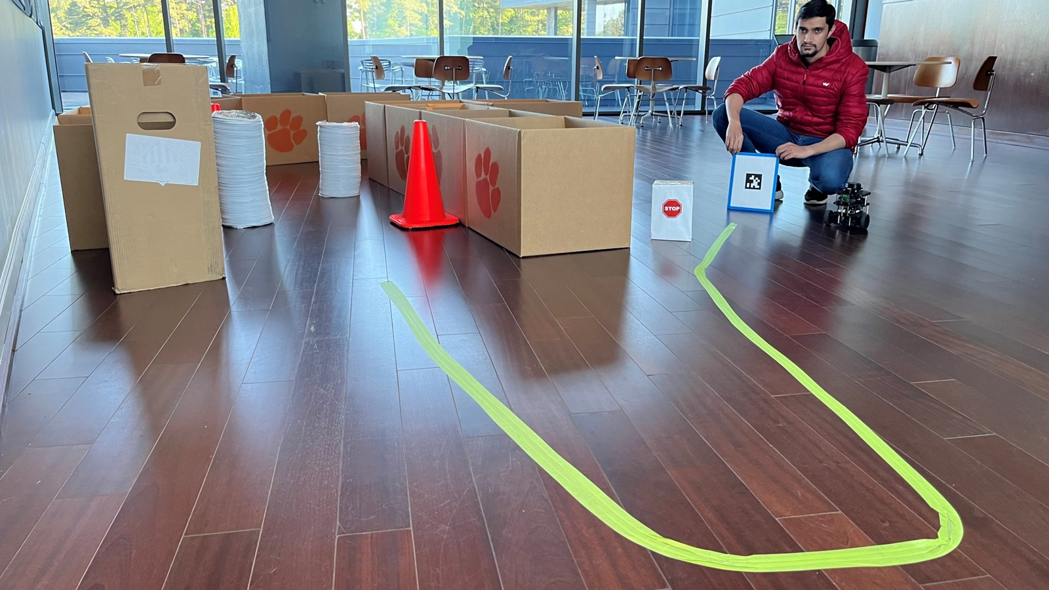
Project Tasks
Task 1: Wall Following
Task 2: Obstacle Avoidance
Task 3: Line Following
Task 4: Stop Sign Detection
Task 5: AprilTag Tracking

Slide 4
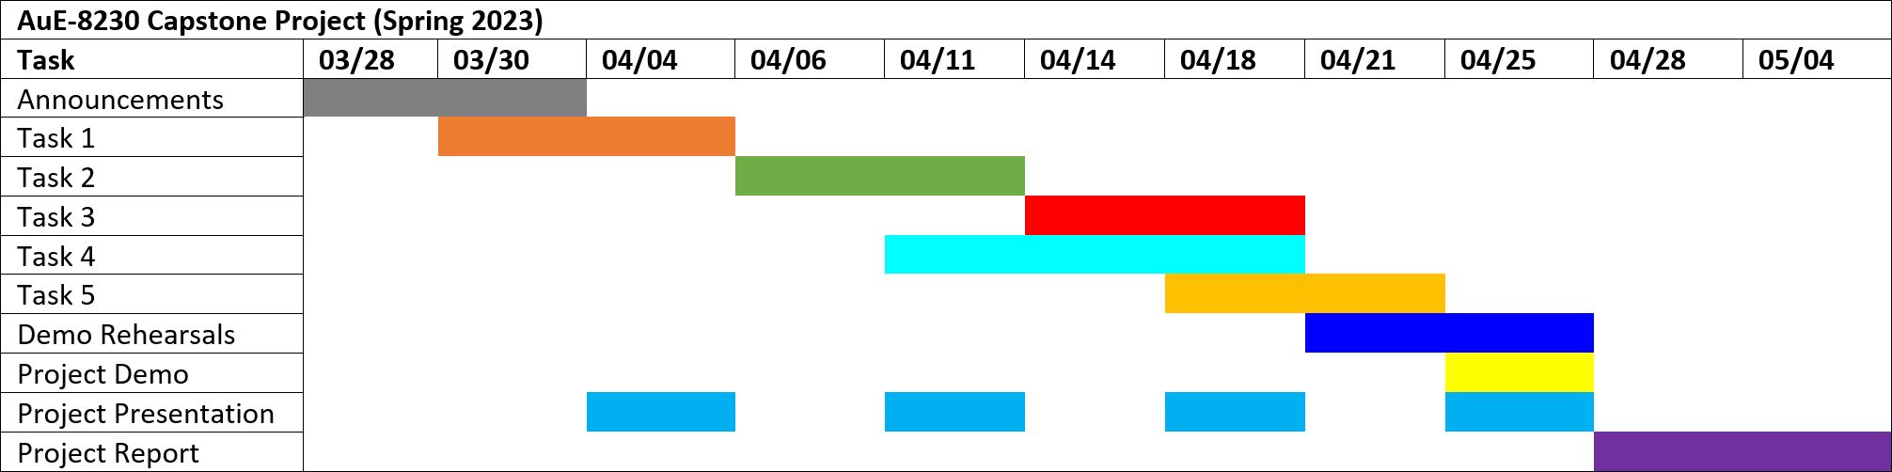
Project Timeline
Task 1: Wall Following
Task 2: Obstacle Avoidance
Task 3: Line Following
Task 4: Stop Sign Detection
Task 5: AprilTag Tracking

Slide 5
Responsibility Assignment Matrix
Task 1: Wall Following
Task 2: Obstacle Avoidance
Task 3: Line Following
Task 4: Stop Sign Detection
Task 5: AprilTag Tracking
Note: Responsibility does not directly indicate contribution. Both members contributed equally to this project and have no conflict of interest to declare.
RESPONSIBILITY | Task 1 | Task 2 | Task 3 | Task 4 | Task 5 | Integration
Algorithm development | Tanmay | Chinmay | Tanmay | Chinmay | Chinmay | Chinmay
Simulation setup | Chinmay | Tanmay | Chinmay | Tanmay | Chinmay | Chinmay
Simulation deployment | Chinmay | Tanmay | Chinmay | Tanmay | Tanmay | Chinmay
Real-world deployment | Tanmay | Chinmay | Tanmay | Chinmay | Tanmay | Tanmay
Git repository management | Chinmay | Chinmay | Chinmay | Tanmay | Chinmay | Tanmay
Documentation | Tanmay | Tanmay | Tanmay | Chinmay | Tanmay | Tanmay

Slide 6
Thank you!
…open to questions and suggestions

